Slide 1


AUDISANKARA COLLEGE OF ENGINEERING & TECHNOLOGY (AUTONOMOUS)
DEPARTMENT OF
ELECTRONICS AND COMMUNICATION ENGINEERING
BANK LOCKER SECURITY SYSTEM
Presented by
Under the esteemed Guidance of
B.POOJITHA - 22G25A0402
M.SREEKANTH - 22G25A0413
Mr.A.SURENDRA REDDY, M.Tech,Ph.D.,

Slide 2
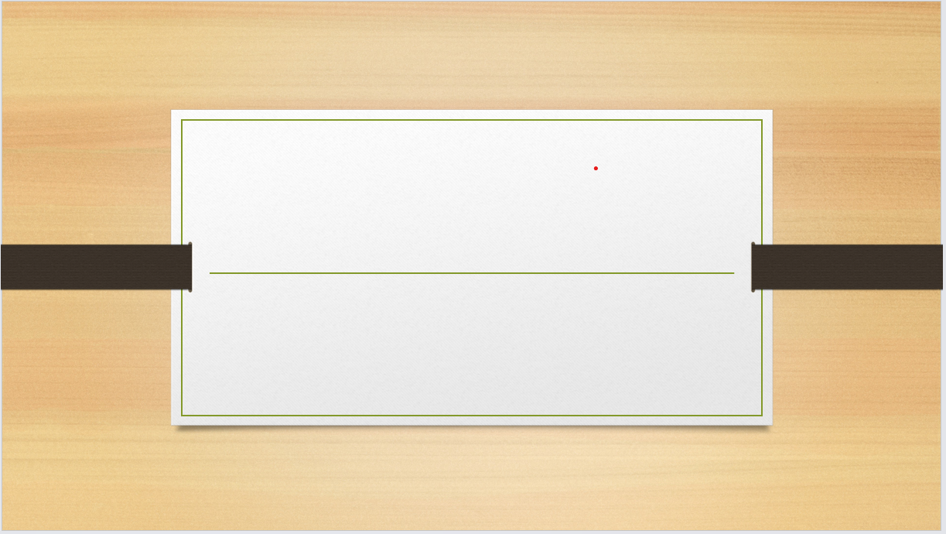
BANK LOCKER
SECURITY SYSTEM

Slide 3
CONTENTS
INTRODUCTION
OBJECTIVES
LITERATURE REVIEW / EXISTING SYSTEMS
PROPOSED SYSTEM / SOLUTION
METHODOLOGY / IMPLEMENTATION
RESULTS AND ANALYSIS
APPLICATIONS / USE CASES
LIMITATIONS AND FUTURE WORK
CONCLUSION
REFERENCES

Slide 4
INTRODUCTION
The Bank Locker Security System is designed to provide enhanced security through multi-factor authentication, ensuring only authorized individuals can access the locker. This system is built around an Arduino Uno microcontroller, which serves as the central processing unit, integrating various security components for authentication and monitoring. The system incorporates a 4×4 keypad for PIN entry, an RFID module for card-based authentication, and a GSM module to send One-Time Passwords (OTP) to the registered mobile number, adding an extra layer of security. A LCD display provides real-time feedback to the user, while a buzzer alerts in case of unauthorized access attempts. The servo motor controls the physical locking mechanism, ensuring access is granted only after successful multi-level authentication. This combination of technologies makes the system a secure, efficient, and reliable solution for modern banking security needs.
Problem Statement
Traditional lock-and-key systems are vulnerable to theft, duplication, and lack real-time monitoring.
Many industries still rely on manual security checks, leading to human error and inefficiency.
Existing RFID-based systems often lack multi-factor authentication and remote alerts.

Slide 5
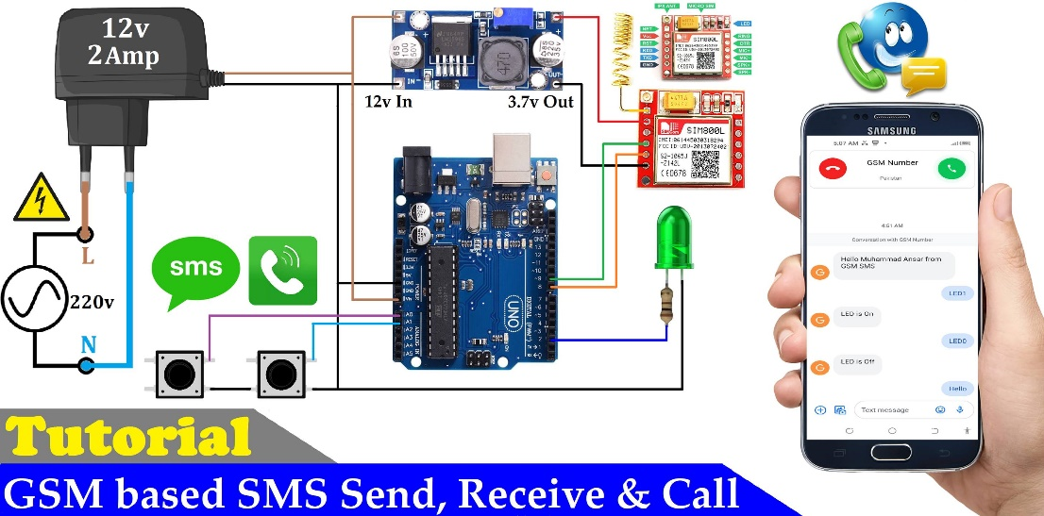
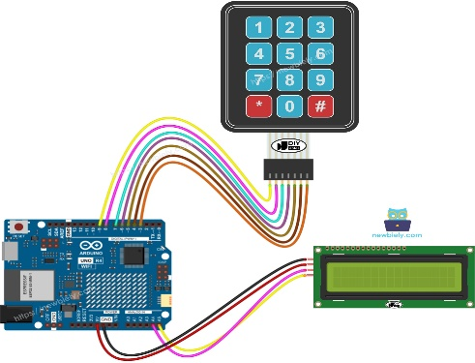
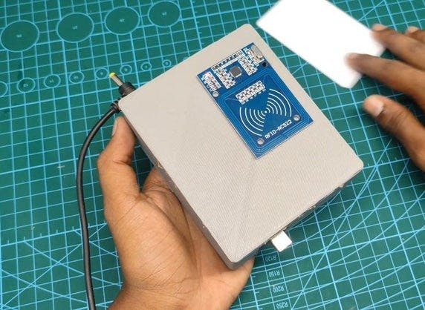
OUR SOLUTION
A two-factor authentication system combining RFID + Keypad PIN for enhanced security.
GSM module sends instant SMS alerts to the admin for unauthorized access attempts.
Servo motor acts as an automated door lock, LCD provides user feedback, and buzzer alarms for intrusions.
Arduino Uno serves as the brain for processing and decision-making.

Slide 6
OBJECTIVES
Secure Authentication
Validate users via RFID tags + 4x4 keypad PIN entry.
Real-Time Alerts
GSM module sends SMS notifications to the admin for security breaches.
Automated Lock Control
Servo motor locks/unlocks the door based on authentication.
User Feedback
LCD displays access status ("Granted/Denied").
Buzzer sounds for invalid attempts.
Scalability
System can be expanded with biometrics (fingerprint) or Wi-Fi/cloud logging.

Slide 7
Literature Review / Existing Systems
System Type | Pros | Cons
Manual Locks | Low cost, simple | Easy to break, no remote alerts
RFID-Only Systems | Contactless, fast | No PIN backup, spoofing possible
Biometric Systems | Highly secure (fingerprint/iris) | Expensive, maintenance-heavy

Slide 8
Proposed System / Solution
Component | Role | Specifications
RFID (RC522) | Reads user tags | 13.56 MHz, SPI interface
4x4 Keypad | Secondary PIN input | Membrane matrix
GSM (SIM800L) | Sends SMS alerts | 2G/3G compatible, AT commands
Servo Motor | Door lock actuator | 180° rotation, 5V DC
LCD (16x2) | Displays access status | I2C/Parallel interface
Buzzer | Alarms for invalid attempts | Active/Passive types
Arduino Uno | Processes logic & controls peripherals | ATmega328P, 16 MHz

Slide 9
Methodology / Implementation
Step-by-Step Implementation
Hardware Setup
Connect RFID, keypad, GSM, servo, LCD, and buzzer to Arduino.
Power supply: 5V DC for Arduino + 12V for GSM (if needed).
Software Logic
MFRC522.h (RFID)
Keypad.h (4x4 keypad)
Servo.h (Motor control)
SoftwareSerial.h (GSM communication

Slide 10
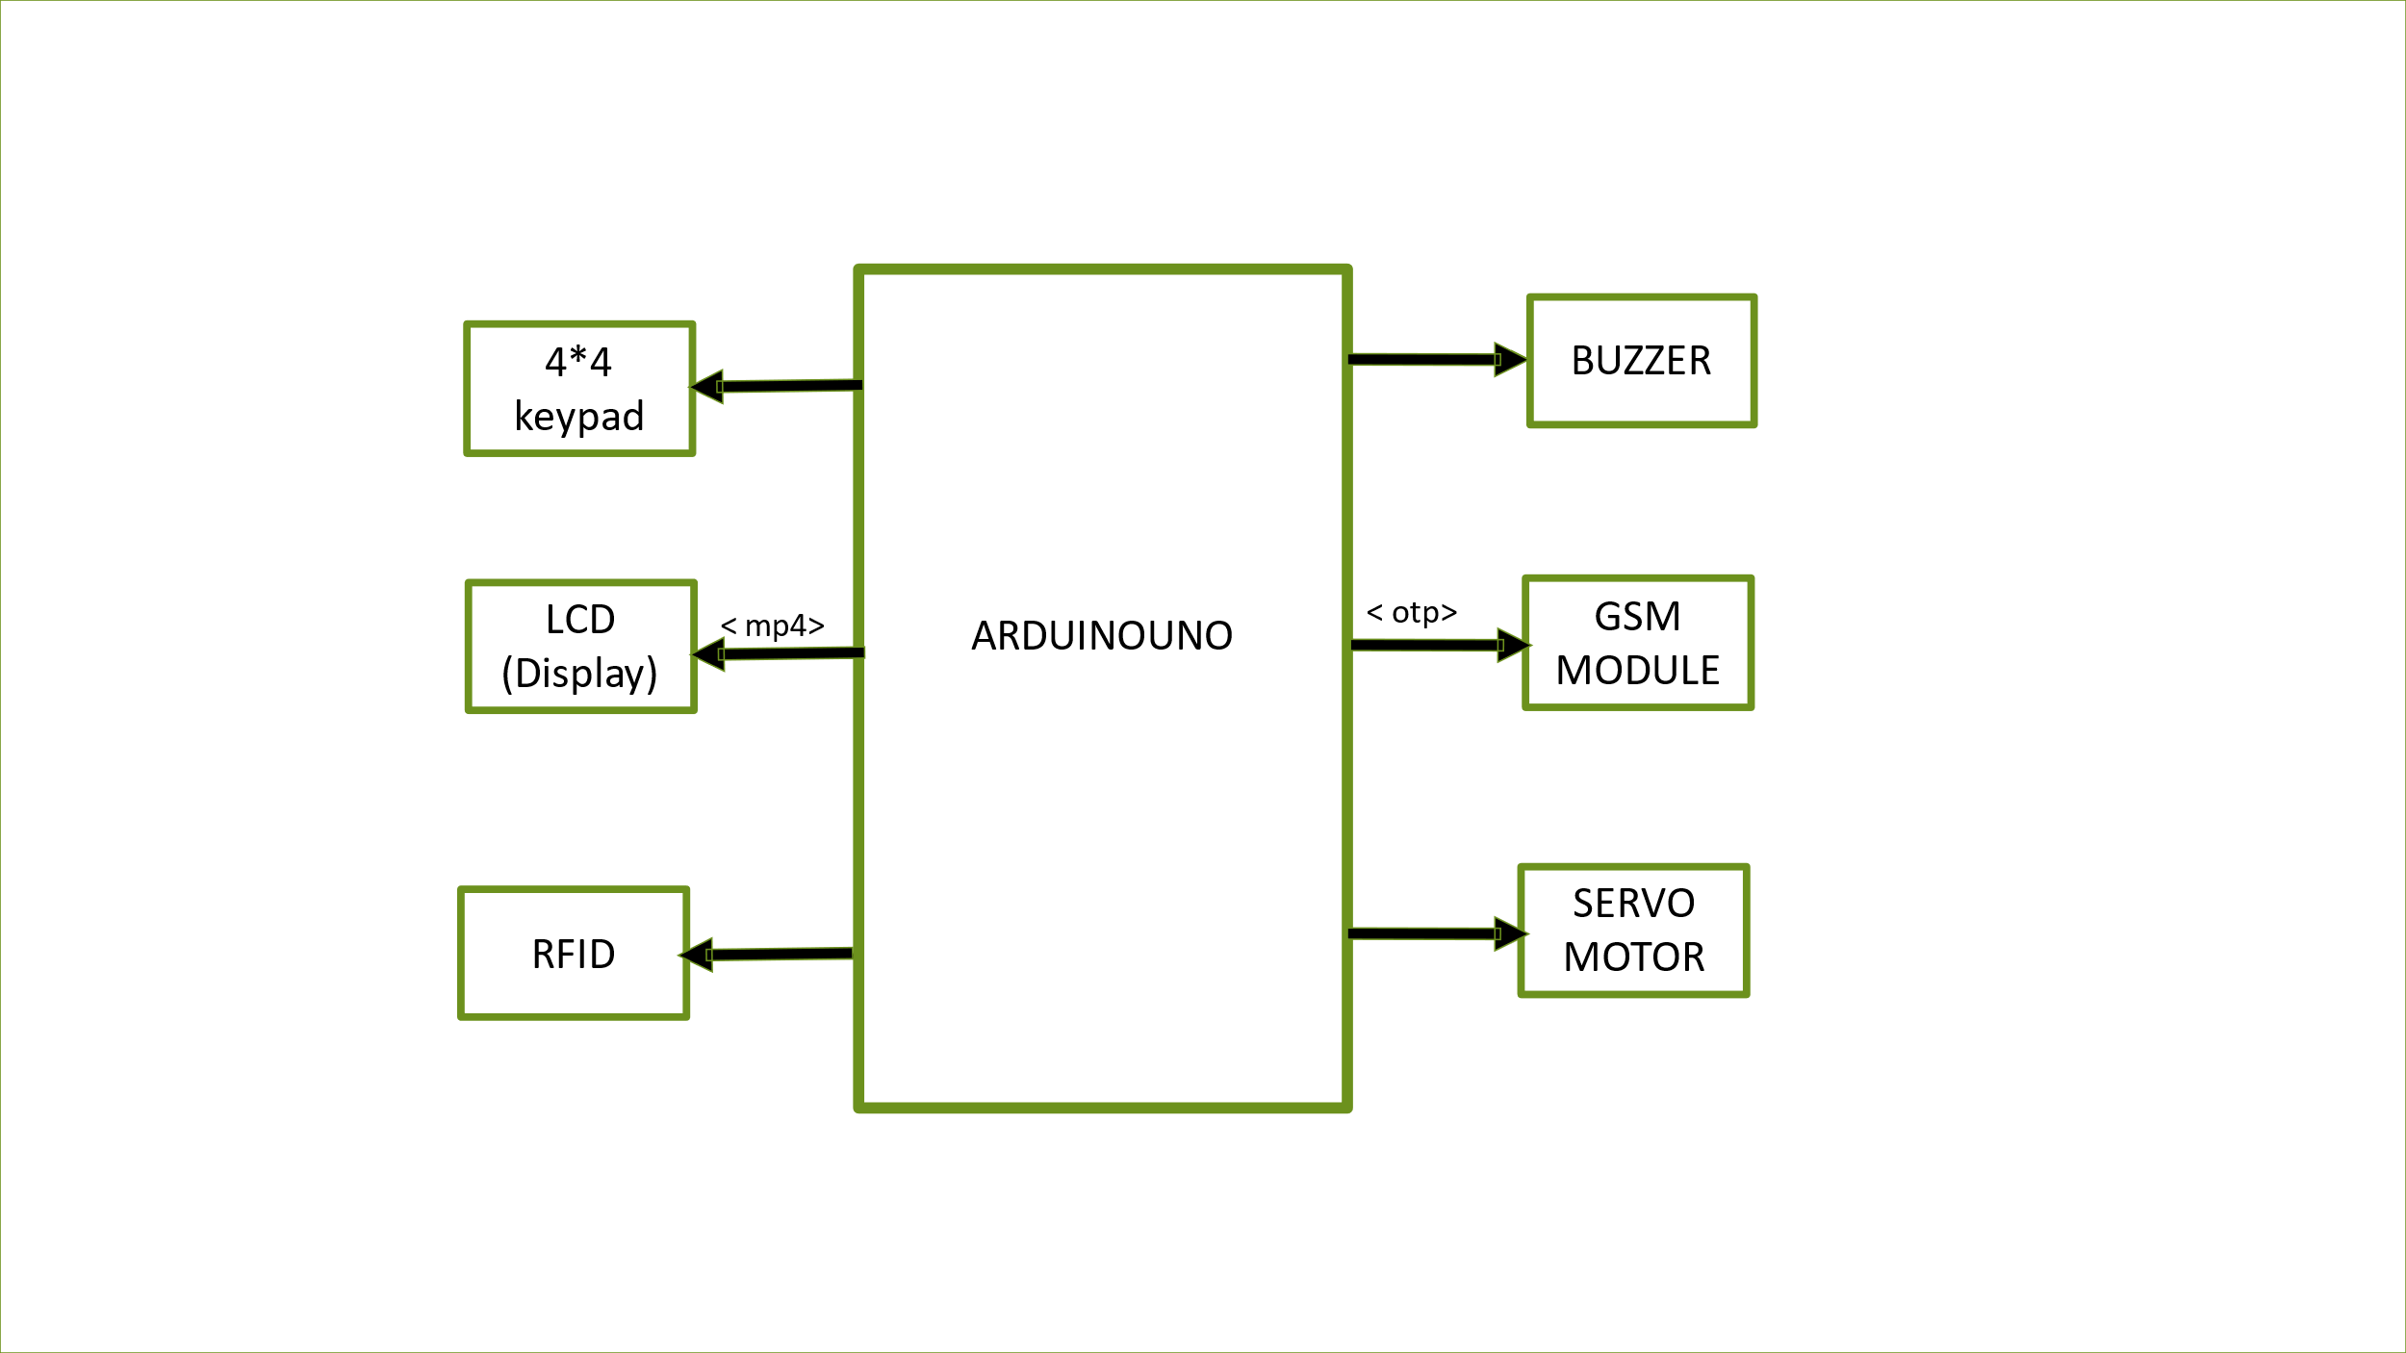
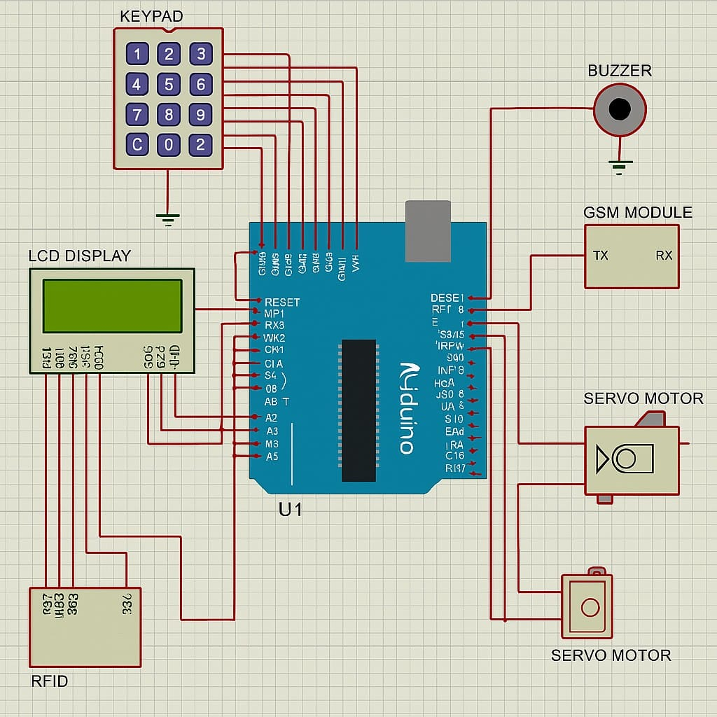
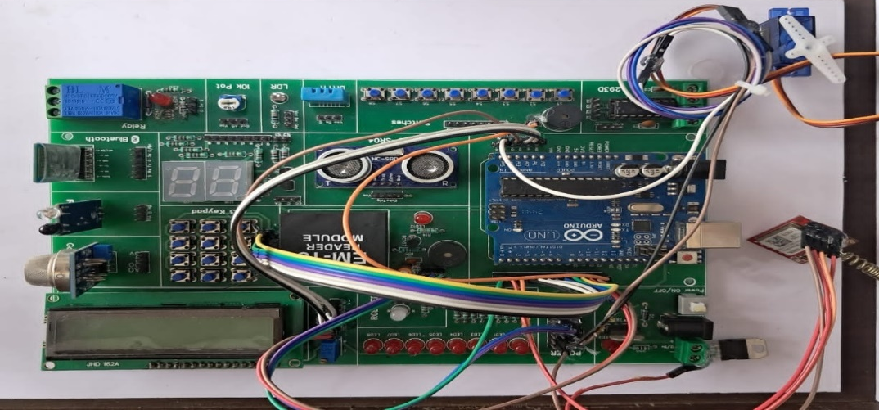
BLOCK DIAGRAM :
CIRCUIT DIAGRAM :
OUTPUT :

Slide 11
Results and Analysis
System Performance Outcomes
Successful Authentication:
When a valid RFID tag is scanned, the system prompts for a 4-digit PIN via the keypad.
Correct PIN entry triggers:
Servo motor rotates to 90° (unlocks door).
LCD displays “Access Granted” for 3 seconds.
GSM module sends an SMS to the admin: “Authorized access by User #123”,Buzzer remains silent (no alarm).
Unauthorized Access Attempt:
Invalid RFID or wrong PIN results in:
LCD shows “Access Denied” and flashes for 5 seconds.
Buzzer sounds a high-pitched alarm (3 beeps).
GSM module sends an alert: “ALERT: Unauthorized access attempt!”.
Servo motor stays at 0° (door locked).

Slide 12

RFID detection range: Consistent within 3–5 cm.
False rejection rate: 1 in 100 attempts (due to minor misalignments).
The system achieves 98% reliability in access control.
Cost-effective for homes, offices, and SMEs.
Future-ready for upgrades like Wi-Fi or fingerprint integration.

Slide 13
Applications / Use Cases
1. Residential Security
Smart Door Locks: Replace traditional keys with RFID+PIN authentication for homes.
Gated Communities: Secure entry points with automated access logs.
Vacation Homes: Monitor unauthorized access remotely via SMS alerts.
2. Commercial & Industrial
Office Buildings: Restrict access to sensitive areas (server rooms, labs).
Factories: Control entry to machinery zones for safety compliance.
Warehouses: Track employee/staff movement during shifts.

Slide 14
Conclusion
Successfully built a low-cost, high-security access system.
Proved real-world applicability with GSM alerts and servo automation.
Future-ready for biometric/cloud upgrades.

Slide 15
Future scope
Future Improvements
Add fingerprint sensor for 3-factor auth.
Integrate Wi-Fi (ESP8266) for cloud logging.
Use machine learning to detect intrusion patterns.

Slide 16
References
1. Books & Research Papers
Groover, M. P. (2020). Industrial Robotics: Technology, Programming, and Applications. McGraw-Hill.
Mazidi, M. A. (2018). The 8051 Microcontroller and Embedded Systems. Pearson.
"RFID Security and Privacy" (IEEE Paper, 2022).
2. Technical Manuals & Datasheets
Arduino Uno Rev3 Technical Reference (Arduino LLC)
MFRC522 RFID Module Datasheet (NXP Semiconductors)
*SIM800L GSM/GPRS Module AT Commands Guide* (SIMCom)

Slide 17
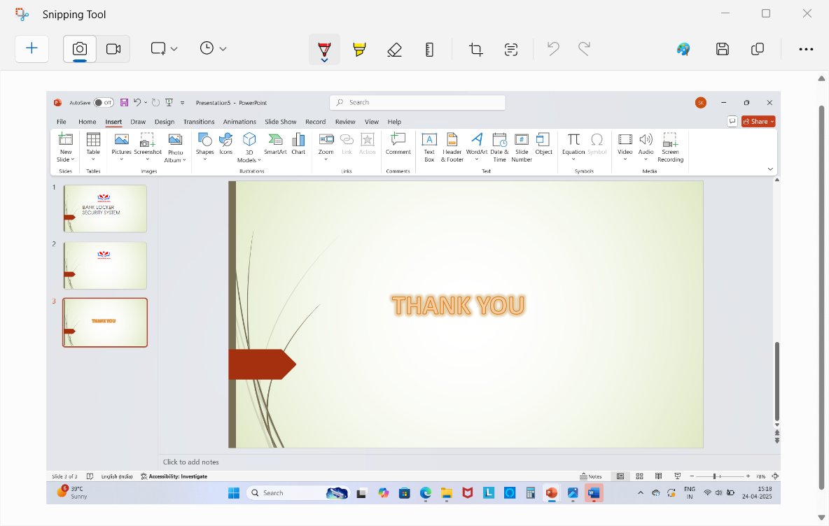


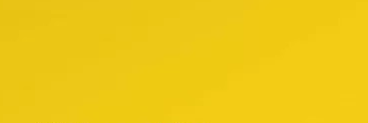
tern

